Slide 1

MS Excel
Advance Course

Slide 2
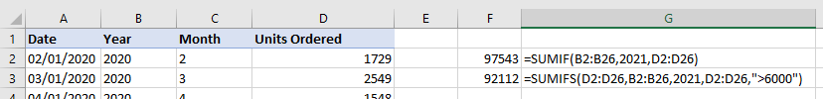
Aggregate function with condition
SUMIF, SUMIFS, COUNTIF, COUNTIFS, AVERAGEIF, AVERAGEIFS
Allows you to perform aggregate operation with at least 1 condition

Slide 3
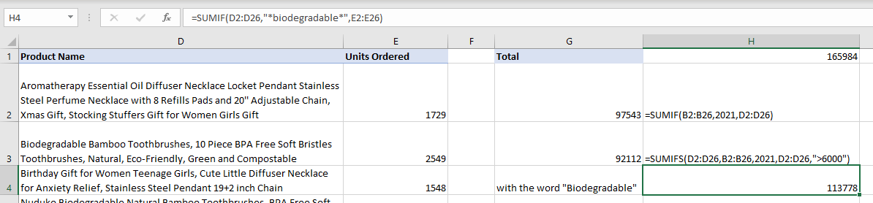
Using wildcards in aggregate function

Slide 4
Criteria Examples
Criteria Type | Example | Result
Number | 54 | Looks for any number equal to 54
Logical Expression | ">100" | Looks for any number greater than 100
Cell Reference | A15 | Looks for any value equal to the value in cell A15
Wildcard | "W*" | Looks for any value that starts with a W
Function | =TODAY() | Looks for any value that matches the current date
Expression and Function | “>”&AVERAGE(B1:B10) | Looks for any number that is greater than the average of the range

Slide 5

PRACTICE EXERCISE

Slide 6

Performing Data Analysis and Business Intelligence

Slide 7
Paste Special
Paste | Paste Special
Everything in the source cell or range - data, formatting, formulas, validation, comments - is pasted to the destination cell(s) | Allows you to select which property of the cell you want to paste from the source cell. E.g. Text Only Formatting Transpose your text ..and more

Slide 8
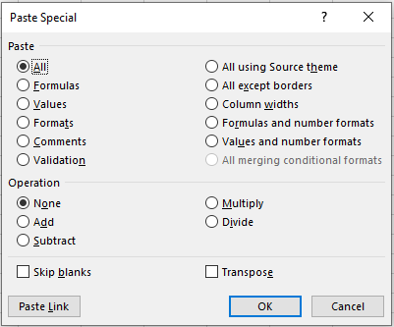
What can I do with Paste Special?

Slide 9
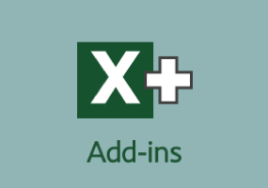
Data Analysis ToolPak
This is an Excel Add-in that allows you to perform complex statistical or engineering analytics by just providing the parameters needed.
This can only be used one worksheet at a time.

Slide 10
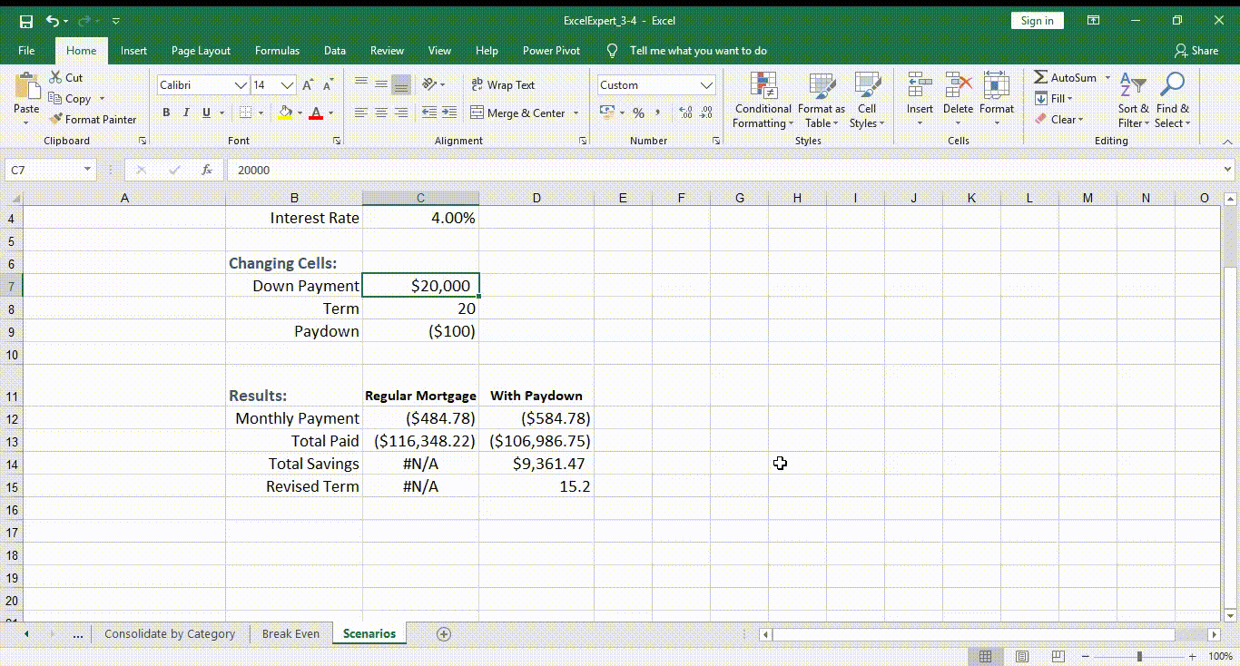
Enabling Data Analysis ToolPak
Go To File
Options
Add-Ins
Select Analytics ToolPak

Slide 11
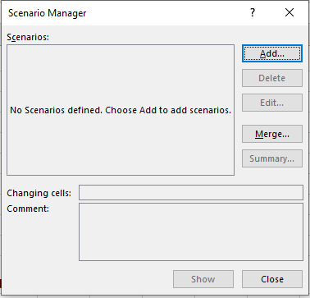
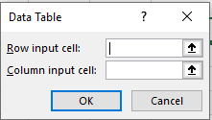
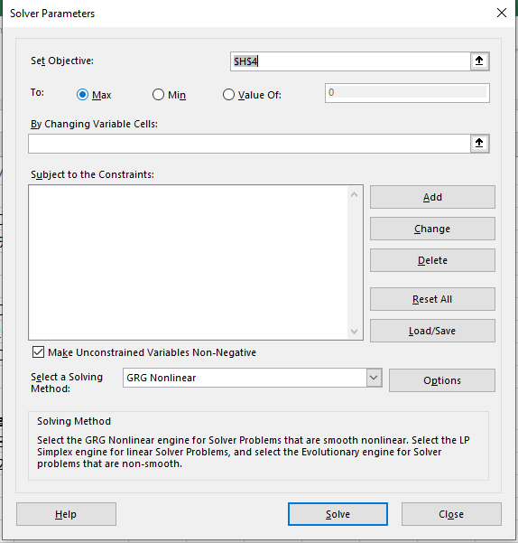
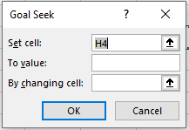
What-if Analysis
Data Table
Scenario Manager
Goal Seek
Solver
Notes:
1.Scenario Manager – Allows you to get results from different scenarios. You can create different groups of values on a worksheet and then switch to any of these new scenarios to view different results.
2.Goal Seek – If you know the desired number from a formula, but are not sure what the input values are, Goal Seek feature will be able to help you with this problem.
3.Data Tables – Allows you to see results for different values for formulas with different inputs. The result will then be displayed in table format where you can see and compare the values.
4.Solver – Solver adjusts the values in the decision variable cells to satisfy the constraints and produce the result you want for the objective cell.

Slide 12
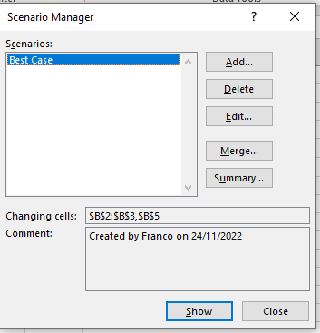
Using Scenario Manager
Allows you to get results from different scenarios.
You can create different groups of values on a worksheet and then switch to any of these new scenarios to view different results.
Notes:
Demo on Scenario Manager

Slide 13
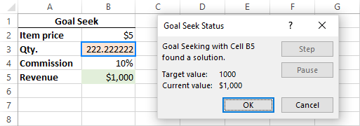
Using Goal Seek
If you know the desired number from a formula, but are not sure what the input values are, Goal Seek feature will be able to help you with this problem.

Slide 14
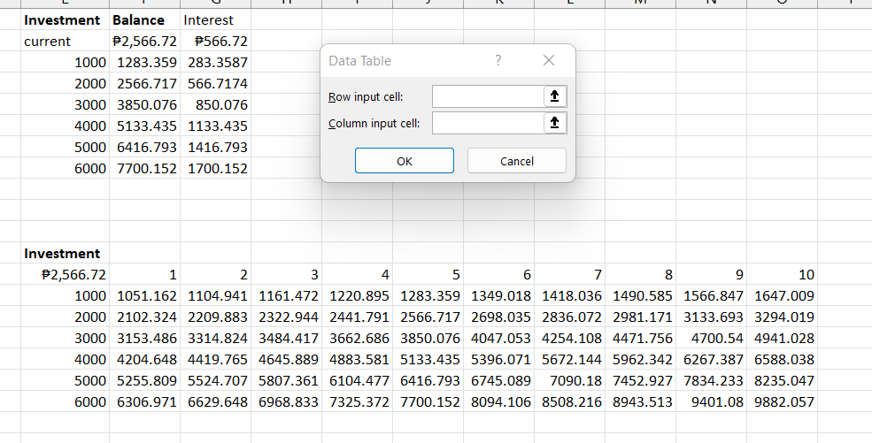
Using Data Table
Allows you to see results for different values for formulas with different inputs.
Notes:
1 variable - will show the compounding investment using FV function, specifying the investment amount in the column
2 variable – will show the investment amount over year and initial investment

Slide 15
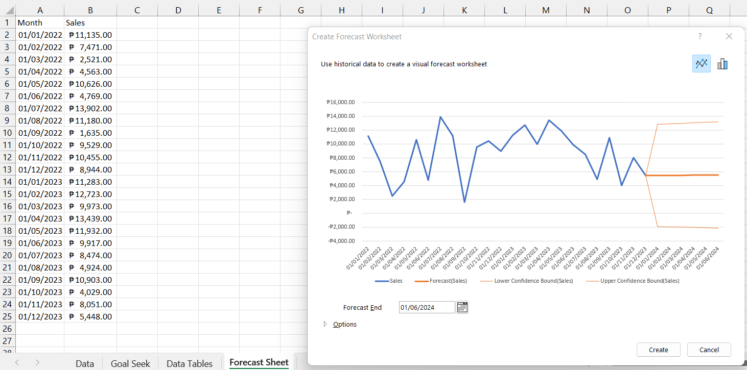
Forecast Sheet
Created a forecasting analysis using ETS Algorithm (Exponential Triple Smoothing), which uses the FORECAST.ETS function.
  FORECAST.ETS(target_date, values, timeline, [seasonality], [data_completion], [aggregation])
This forecasting method is best suited for non-linear data models with seasonal or other recurring patterns.

Slide 16
Using Solver
Finds an optimal value for a formula in once cell called the Objective cell.
You can set constraints or limits on the values of other formula cells on a worksheet.
Used for linear programming problems or linear optimization problems therefore called linear programming solver. Apart from that, it can handle smooth nonlinear and non-smooth problems.
Notes:
Problem: Example: Supposing, you are the owner of a beauty salon and you are planning on providing a new service to your clients. For this, you need to buy a new equipment that costs $10,000, which should be paid by instalments within 12 months.
Goal: Calculate the minimal cost per service that will let you pay for the new equipment within the specified timeframe.

Slide 17
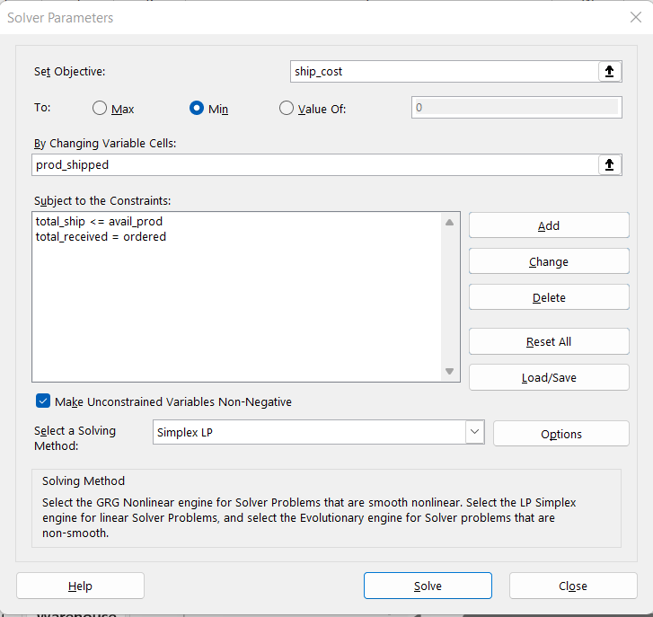
Formulating the Model
Variable Cells – What decisions are to be made.
Constrained Cells – What are the rules and constraints.
Objective Cell – What is the goal.

Slide 18
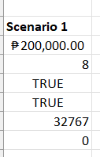
Saving and Loading Models
Excel Solver will tell you how many cells are needed to save your scenario.

Slide 19
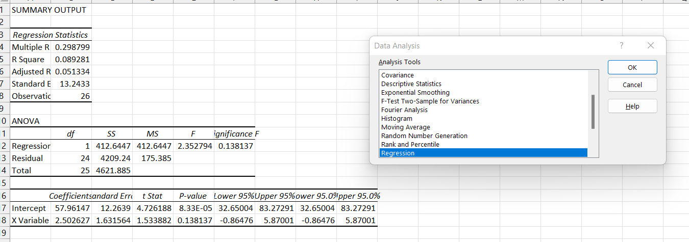
Data Analysis Add-in

Slide 20
PRACTICE EXERCISE

Slide 21

Macros

Slide 22

Automation using VBA and Macro
Macro – An action or a set of actions that you can run as many times as you want.
VBA – the programming language used by Excel to run Macro.
.xlsm – File extension of a worksheet that is macro enabled.

Slide 23
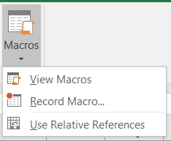
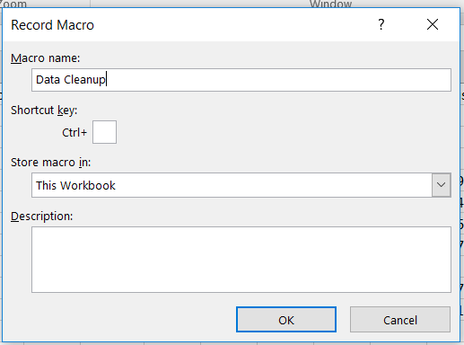
How to use Macro

Slide 24
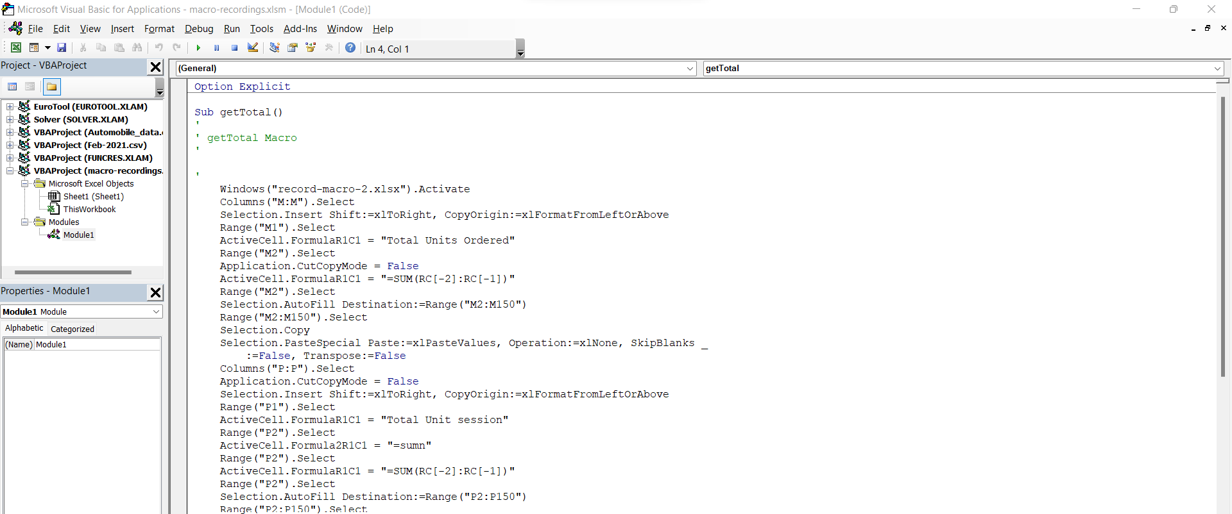
Checking your scripts
Macros as created using VBA scripts
You can see the VBA script by editing your macro recording
Each recording is enclosed in a SUB

Slide 25
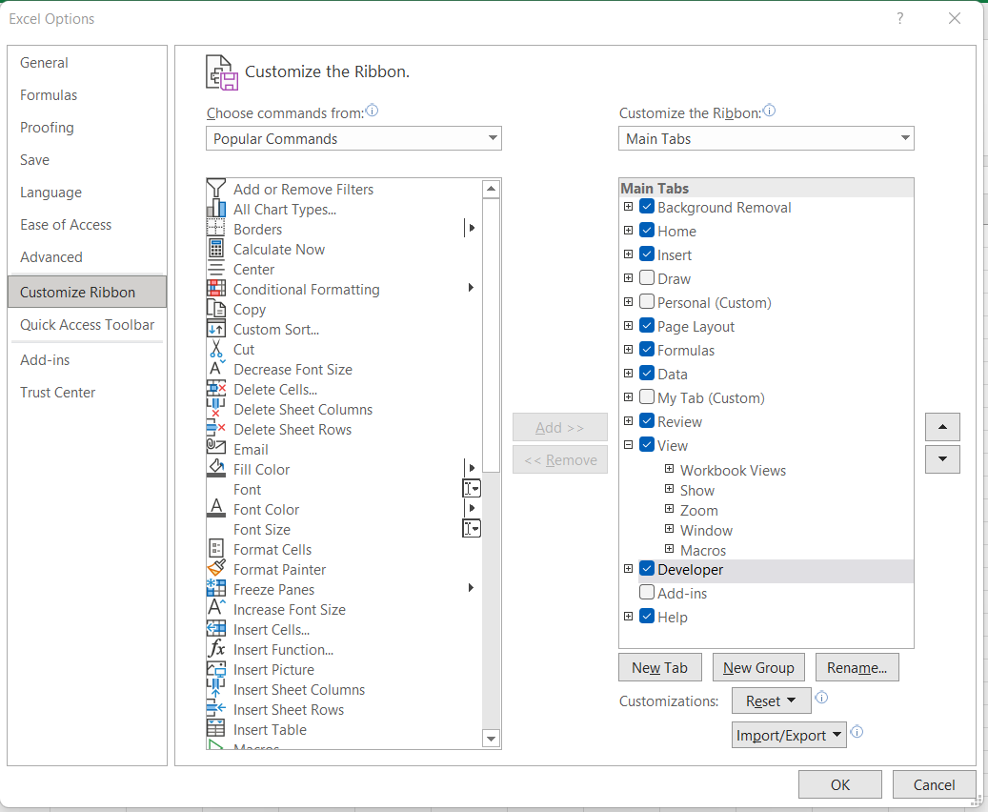
Enabling Developer Tab

Slide 26
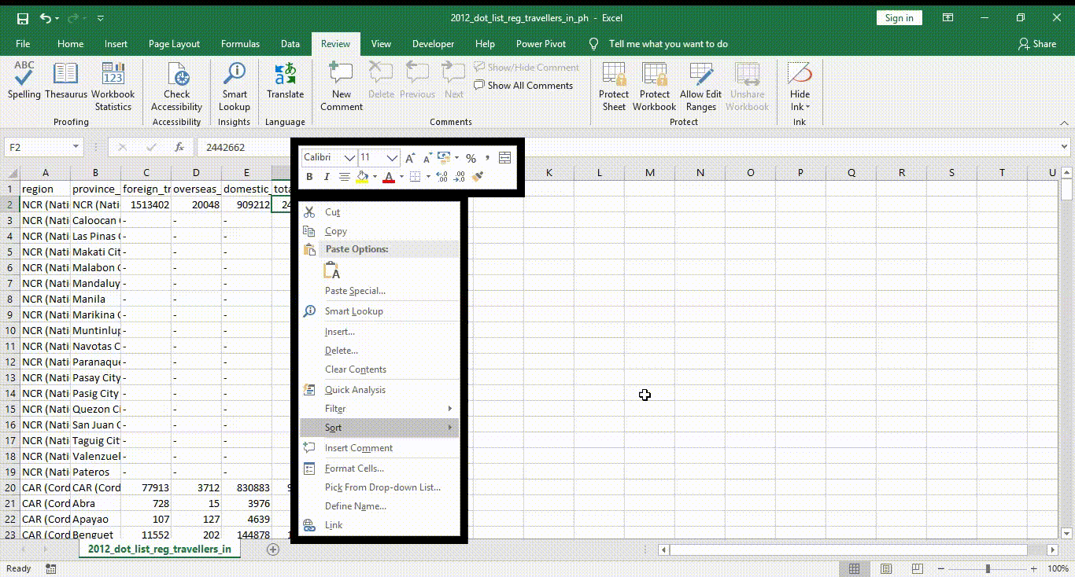

Documentation in your worksheet
Inserting comment will help you explain your data even better

Slide 27

Creating Advanced Visuals

Slide 28

Why Visualize
The main goal of graphic and visualization is to be a tool for your eyes and brain to perceive what lies beyond their natural reach.
The graphics should not just simplify your information, but to clarify them.

Slide 29
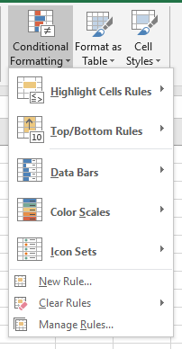
Conditional Formatting
This will give us a real-time emphasis on the data you want to highlight based on different criteria.

Slide 30
Different ways for conditional formatting
Data Bars
Color Scales
Icon Sets
Notes:
Data Bars – A longer bar represents a higher value.
Color Scales – The shade of the color represents the value in the cell.
Icons sets – Each icon represents a range of values.

Slide 31
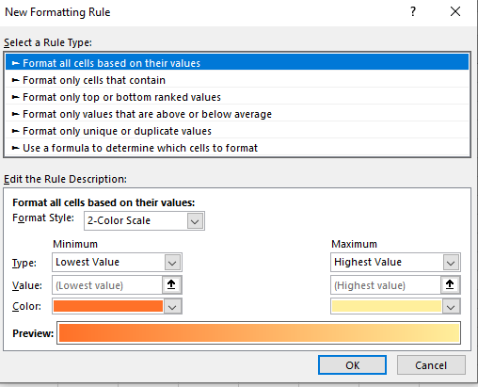
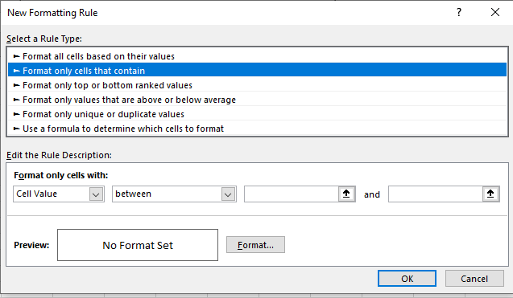
Rules and Criteria
Notes:
Rules or conditions in the Conditional Format allows us to specify the criteria on where and when to apply the formatting.
There are 6 ways of setting a criteria or rule in Excel.
Format Cells Based on their Values – this assigns color to the value based on the Minimum and Maximum settings. You select either 2-color, 3-color scale, data bar, or icon set.
Format Only Cells that Contain – this allows you to create a logical rule and set the cell format. You can set a numerical or text value as the criteria. E.g. between 1 to 10 or A to E

Slide 32
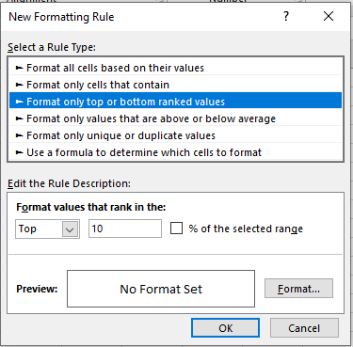
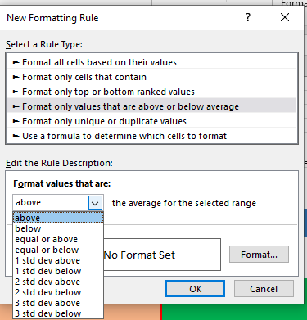
Rules and Criteria
Notes:
Format only top or Bottom ranked values – allows you to create cell format for Top N criteria. Either exact number or by percentage
Format only Values that are above or below average – allows formatting based on the average of the selected range

Slide 33
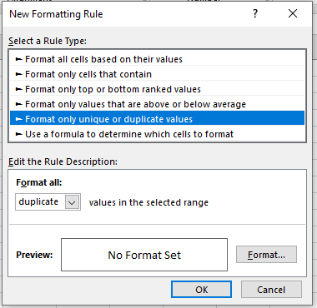
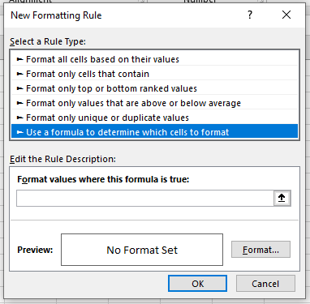
Rules and Criteria
Notes:
Format only unique or duplicate values – format cells for unique or duplicate values
Use a formula to determine which cells to format – format cells using custom formula

Slide 34
Managing Rules
Clear Rules – can clear conditional formatting rules by:
  Selected Cells
  Entire Sheet
  Entire Table
  Entire PivotTable
Manage Rules – allows users to create, edit, and delete rules. This allows management of rules in the worksheet or the whole workbook.
Notes:
After creating a rule, you can either Clear or Edit the rules.

Slide 35
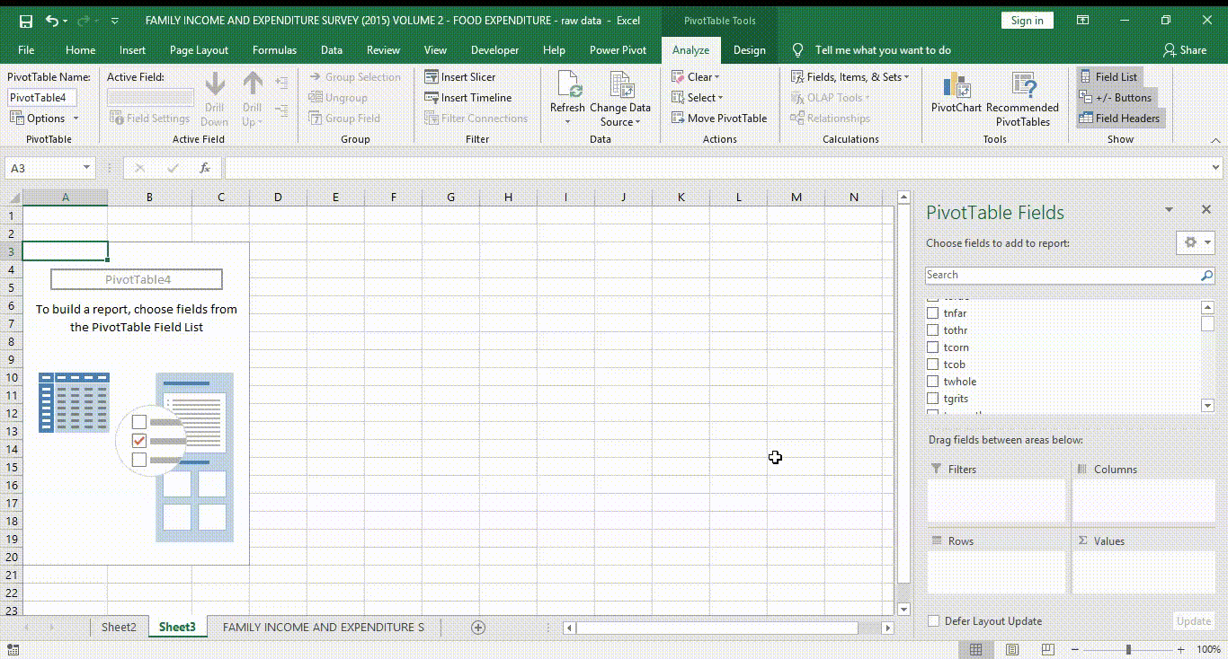
PivotTable
Notes:
PivotTables allows you to extract the significance from a large, detailed data set by aggregating or summarizing them.

Slide 36
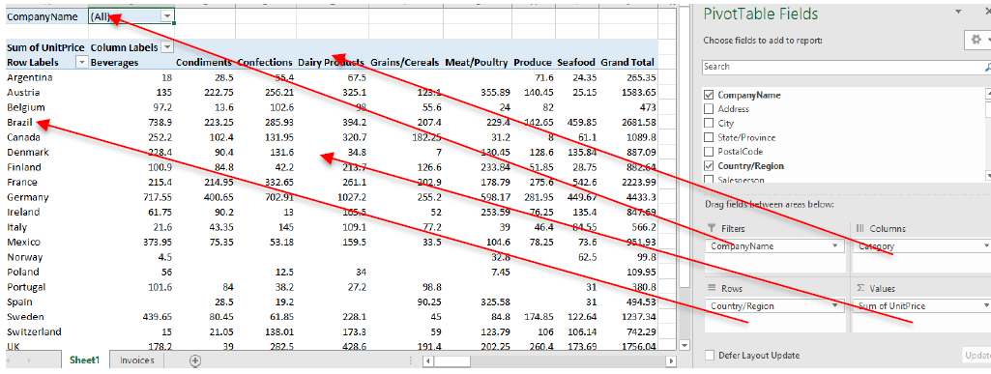
Parts of PivotTable
4
1
2
3
Notes:
Columns – lets you split the value columns into different groups
Rows – Row labels which provide context to the Value box
Values – represents the measures.
Filters – Allows filter of the data block.

Slide 37
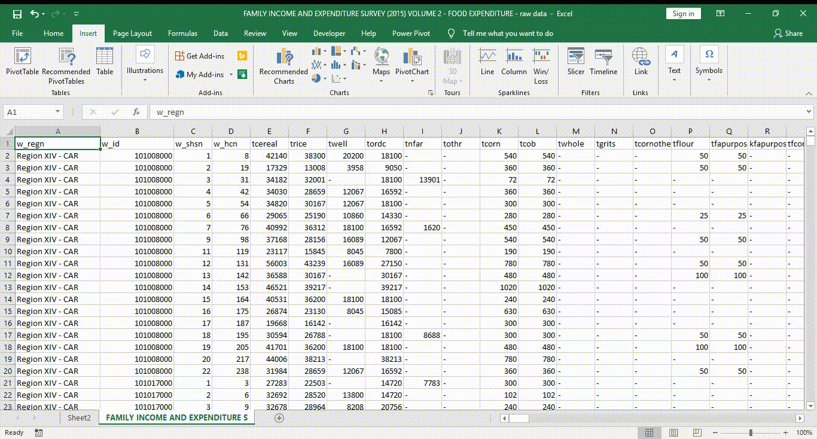
Creating PivotTable
Notes:
1. On the Insert tab, in the Tables group, click PivotTable to open the Create PivotTable dialog box.
2. Enter a table name, name range, or select the cell range you want to create the PivotTable. Make sure to include the column headers of your data.
3. Choose where you want your PivotTable report to be placed: a. New Worksheet (the default) it will create a new worksheet for the PivotTable.
b. Existing Worksheet, enter or select the cell where you want to anchor the upper-left corner of the PivotTable.
4. Click OK. Excel displays the PivotTable Fields pane and two PivotTable Tools tabs: Analyze and Design.

Slide 38
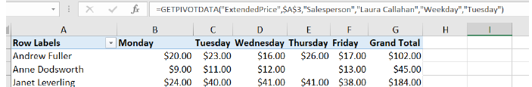
GETPIVOTDATA()
Notes:
Allows you to use your PivotTable as reference in a formula. PivotTable’s data changes a lot and does not remain static since it also references another dataset. You also need to consider that PivotTable address will change every time you pivot, filter, group, and refresh your PivotTable.

Slide 39
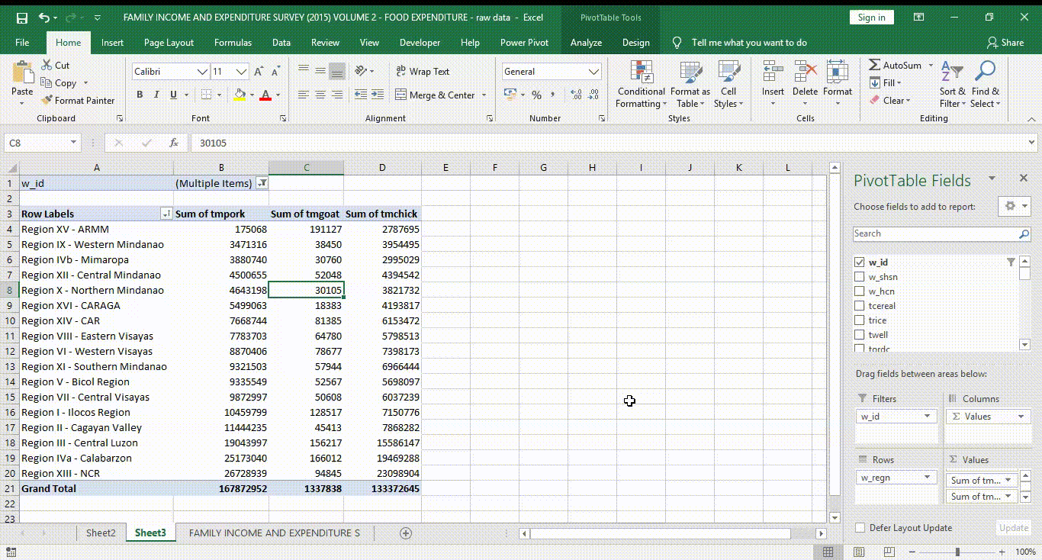
PivotCharts
Notes:
PivotCharts are graphical representation of PivotTables. The difference of a PivotChart to a regular chart are:
1. Allows filter of data.
2. Easy refresh of data to acquire new changes.
3. Moving fields in the PivotTable changes the PivotChart accordingly.

Slide 40
PRACTICE EXERCISE

Slide 41
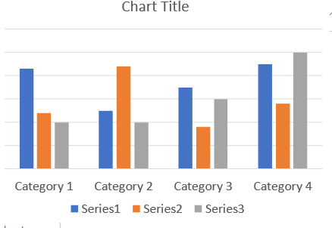
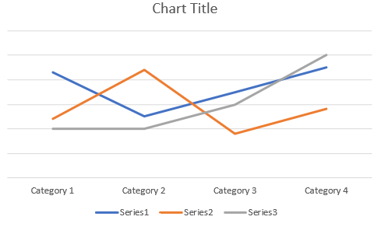
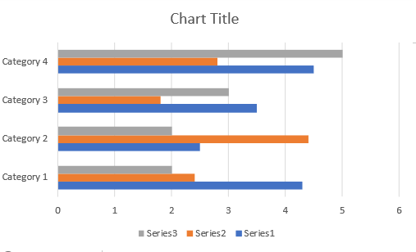
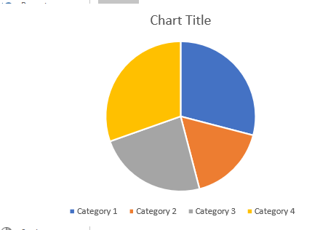
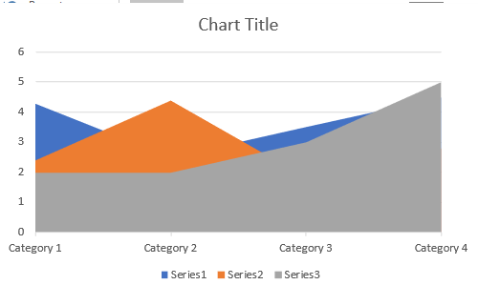
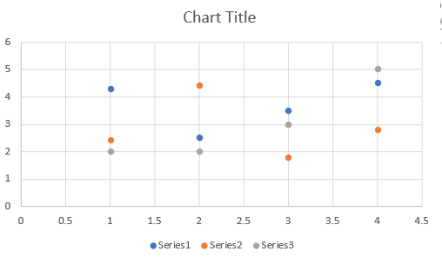
Choosing the right visual for your data
Column
Line
Bar
Pie
Area
Scatter
Notes:
Column It is used to compare values across categories.
Line This is used to display a trend over time
Pie It is best used to compare parts of a whole.
Bar It is best used to compare multiple value
Area Used to emphasize the difference between several data points over a period of time
Scatter It is used to determine the relationship between two different parameters (X,Y).

Slide 42
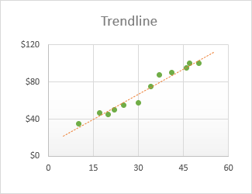
Trendlines
“Line of Best Fit”
It is something we add to a graph to make the pattern even clearer.
Notes:
It is a line through the data points for which the differences between the points above and below the line cancel each other out.
You can add trendlines to two-dimensional area, bar, column, line, stock, XY (Scatter), and bubbles charts that aren’t of stacked type.
Trendline reliability A trendline is most reliable when its R-squared value is at or near 1. When you fit a trendline to your data, Graph automatically calculates its R-squared value. If you want, you can display this value on your chart.

Slide 43
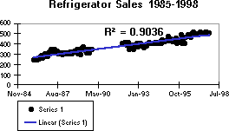
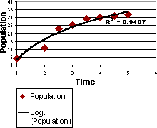
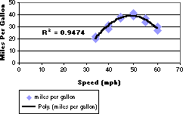
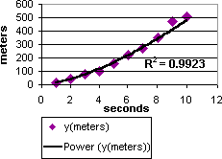
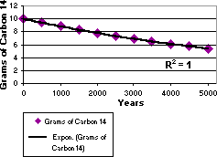
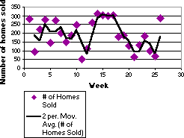
Types of Trendlines
Linear
Polynomial
Logarithmic
Power
Exponential
Moving Average
Notes:
Linear – Use this to see the trend when the dependent variable is related to the independent variable by some constant factor. A linear trendline usually shows that something is increasing or decreasing at a steady rate.
Logarithmic - is the inverse of an exponential trend: the values rise (or fall) quickly in the beginning and then level off.
Polynomial - is a curve constructed out of an equation that uses multiple powers of x. A polynomial trendline is a curved line that is used when data fluctuates.
Power - is a pattern that curves steadily in one direction.
Exponential – is on that rises or falls at an increasingly higher rate.
Moving Average - is one that smooths a data series by averaging the series values over a specified number of preceding periods.

Slide 44
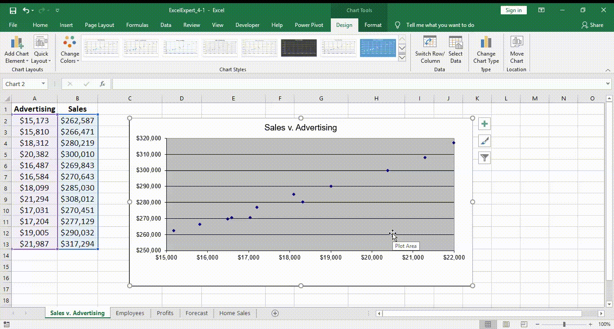
Adding Trendline
Notes:
On the Design tab, in the Chart Layouts group, click Add Chart Element, point to Trendline. You can select the type of trendline you want to add.

Slide 45
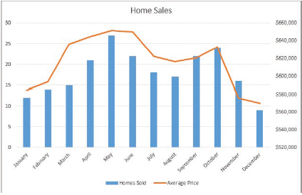
Combination Charts
Also called dual axis charts
Allows you to show data with two different categories

Slide 46
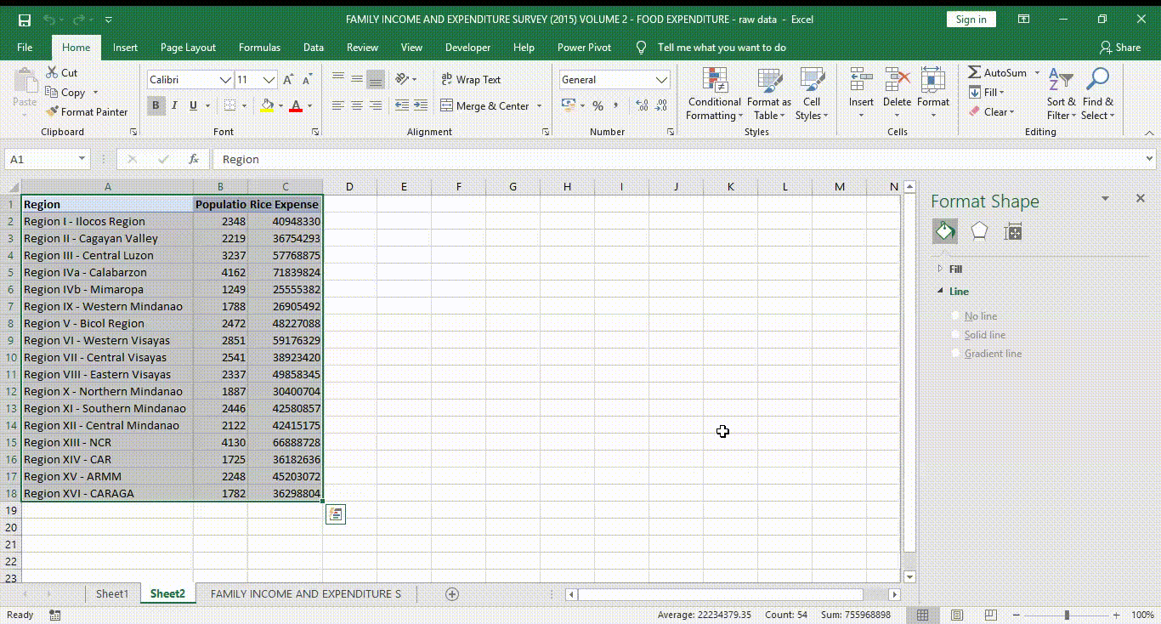
Creating Combination Chart
Notes:
Excel 2013 and up has an option for Combo Charts which makes it easier.
While earlier versions, Excel 2010 and below, needs manual approach in creating combination charts.

Slide 47
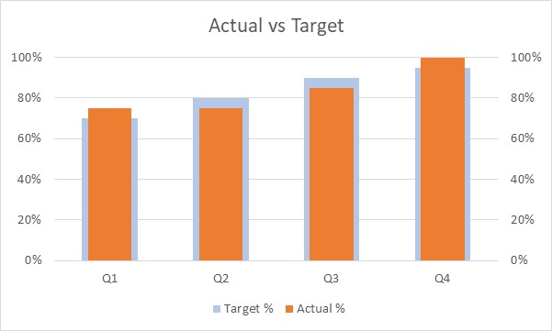
Actual vs Target Charts
Notes:
Select Data
Select Combination Chart
Select the Actual Target Line graph
Go to Chart Design > Change Chart Type
Set Target and Actual to Stacked Column Chart
Set Actual as Secondary Axis
Right click the secondary axis, select format axis
You can set the maximum to 1.0, and major to 0.2
Click the Column chart for actual, right click and select Format Data Series
In the Series Options tab, adjust the Gap Width of your Secondary Axis. You can increase it to make it thinner.
You can make further changes by renaming the Chart Title, and adding axis labels

Slide 48

Gantt Chart
Notes:
Select Start Date data
Got to Insert > Charts > Stacked Bar chart
Click the added chart. Go to Chart Design > Select Data
In the Legend Entries click Add
For Series name, enter Days.
For the Series Value, select the range for Number of Days. Click OK
To Change the Category, click the Edit button in the Horizontal Axis Label.
Select the Range for Activity. Click OK
Right click the Y-Axis name and select Format Axis.
In the Axis options tab, check Categories in reverse order
Go back to your table, select the first date and get the integer value. Copy it.
Right click the X-Axis, click Format Axis
In the Axis options, set the minimum to the start date using the integer value of the date
Right click the start date bar, and click Format Data Series.
You can set the Fill and Line to No Fill and No Line

Slide 49

Bullet Chart

Slide 50

Benchmark Line

Slide 51

Sparklines
Mini Charts
Shows trends in series of value

Slide 52

Creating Sparklines

Slide 53
PRACTICE EXERCISE

Slide 54

Thank you!
This Photo by Unknown Author is licensed under CC BY

